Slide 1
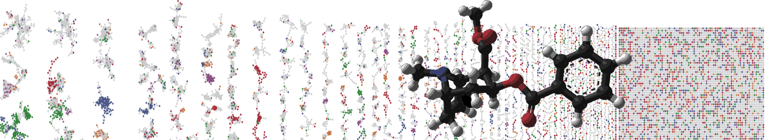


Feature-based molecular networking
Analysis
PRESENTER’S NAME
University of California - San Diego

Slide 2
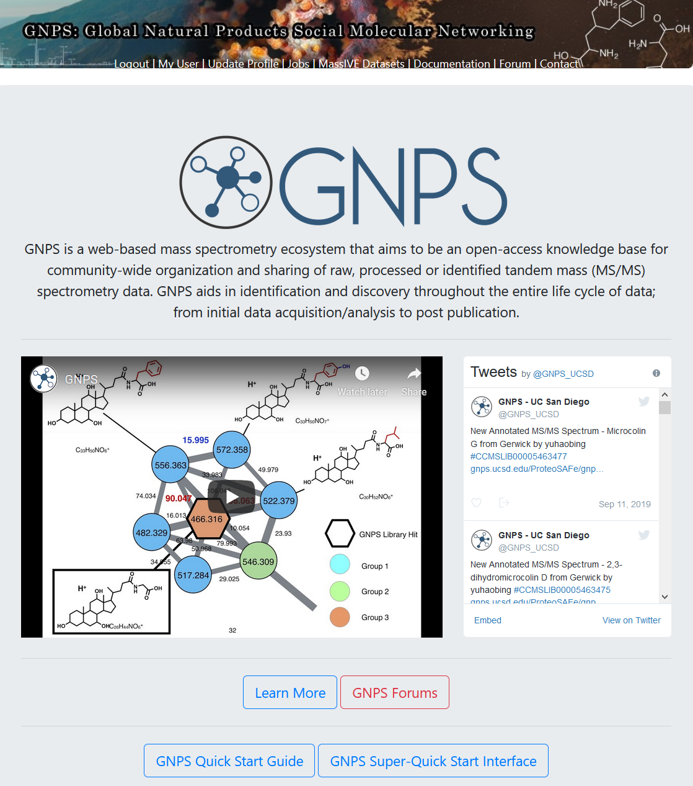
Lets analyze your molecular network!

Slide 3
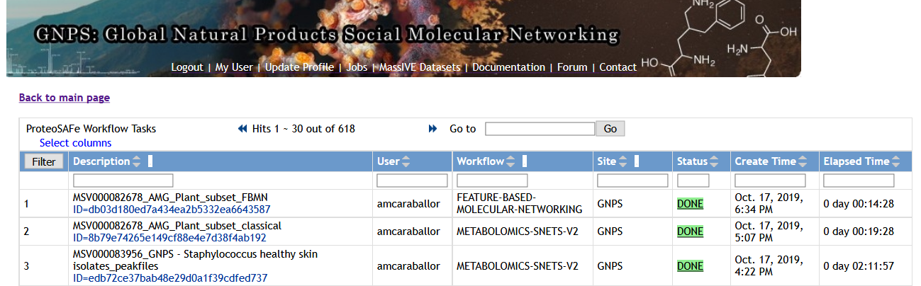
Navigate into your network

Slide 4
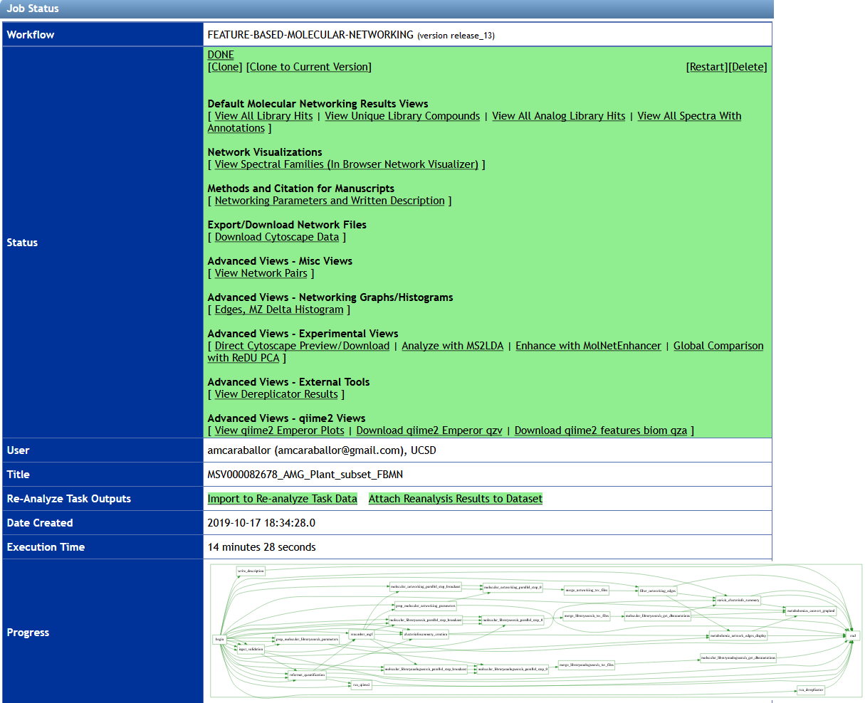
Inspect library hits

Slide 5
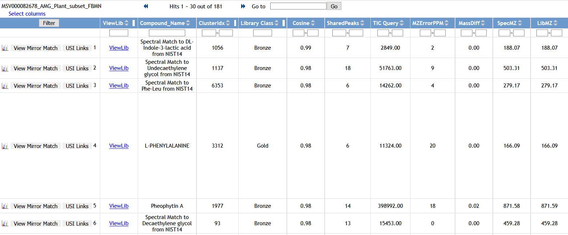
VIEW ALL LIBRARY HITS
2. Filter
1. Type: Cholic

Slide 6
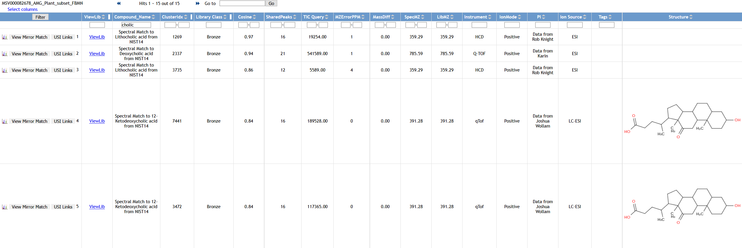
Filtering “Cholic”
Click the spectrum icon

Slide 7
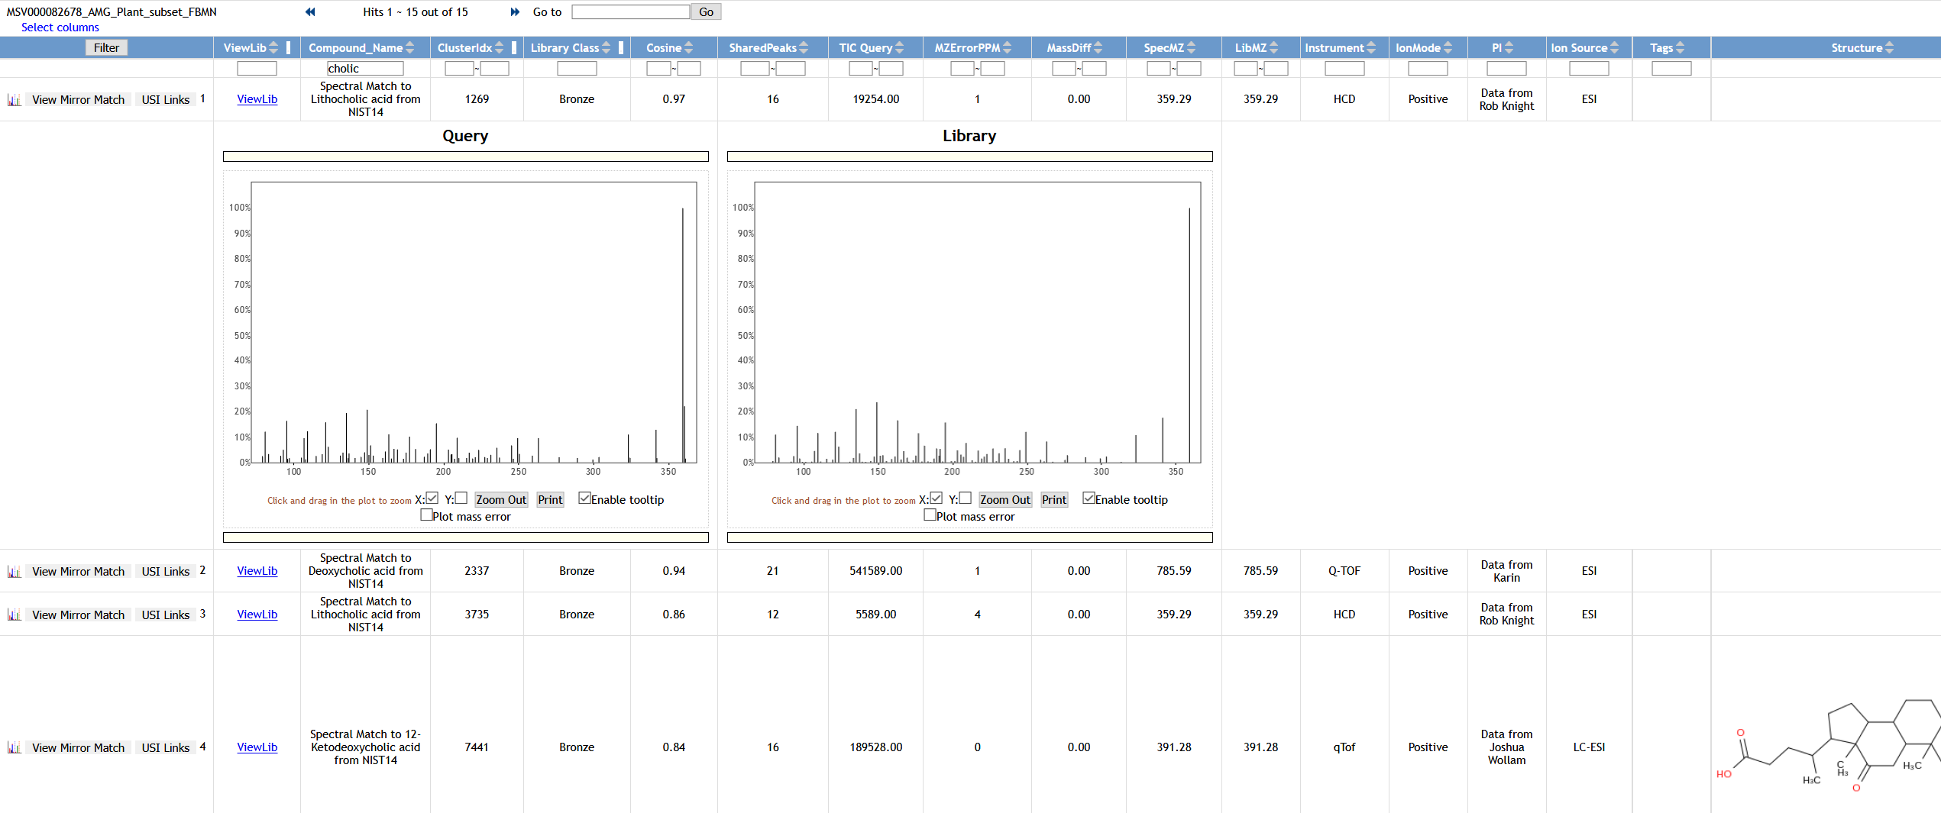
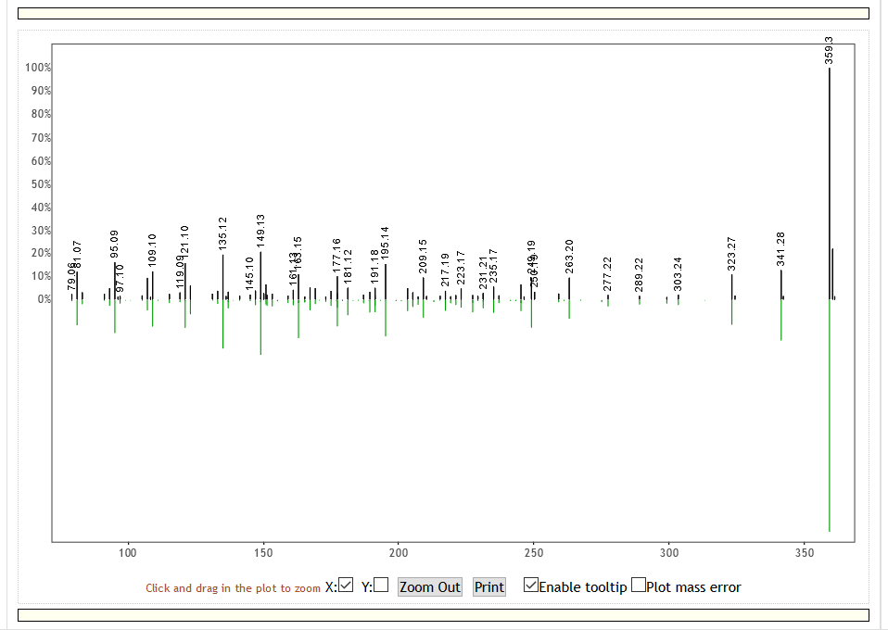
Filtering “Cholic”
Click to “View Mirror Match”

Slide 8
View All Spectra with Annotations

Slide 9
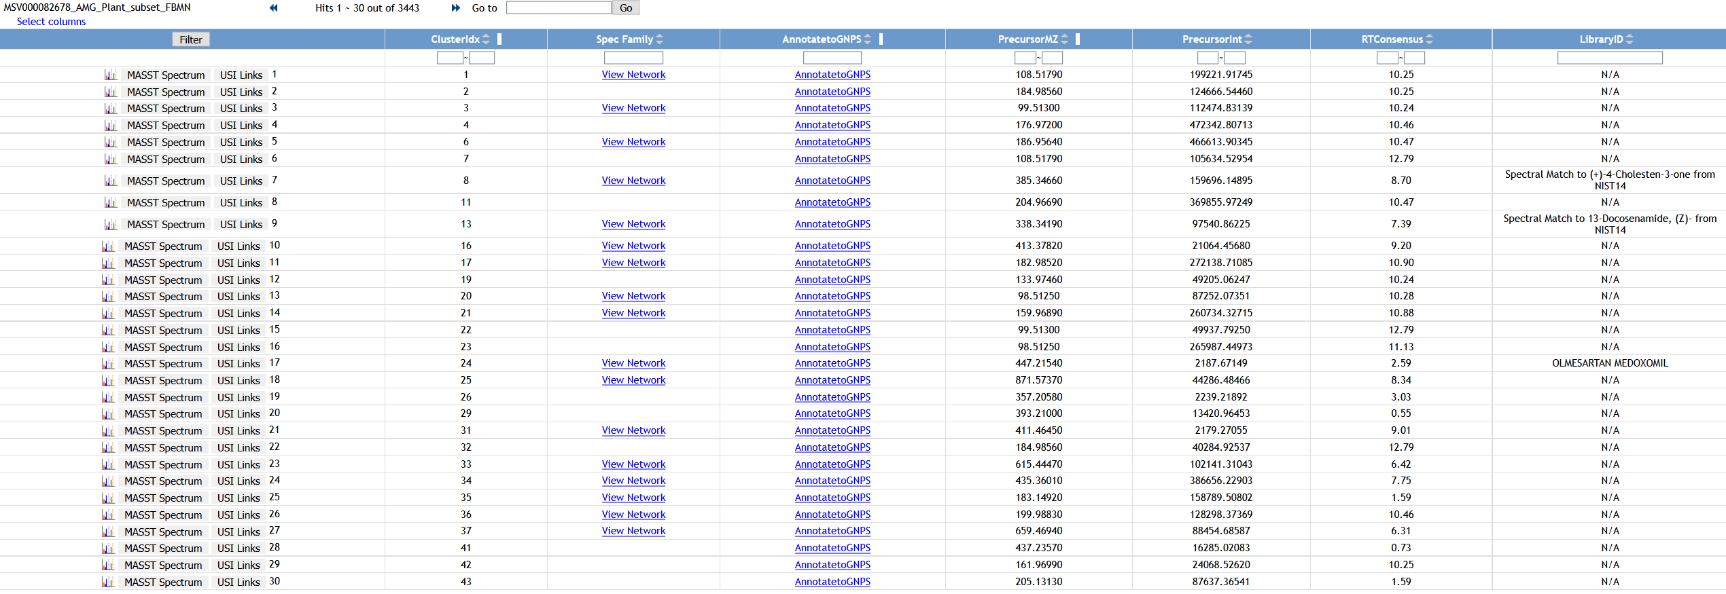
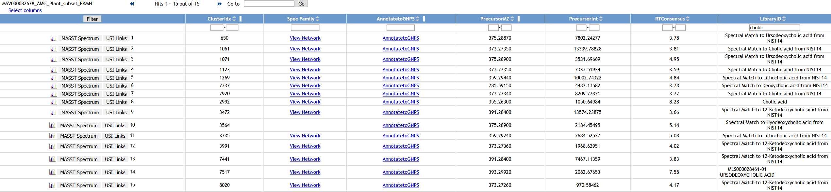
View All Clusters With IDs
Results of Network
Filter
Type: cholic
Click to View Network

Slide 10
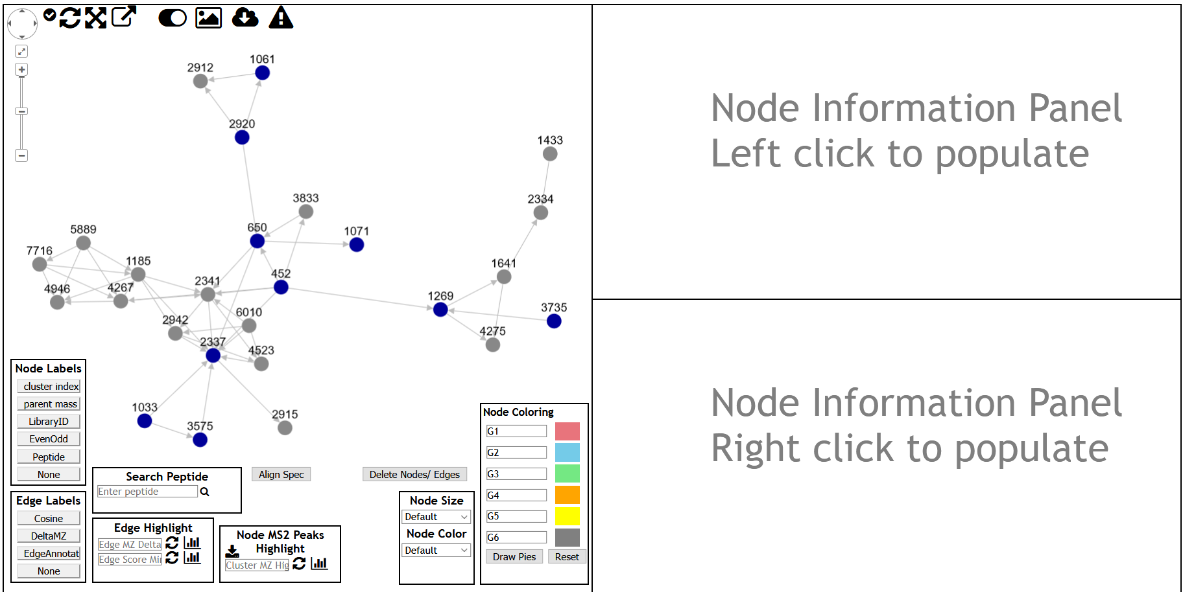
Visualizing the network
Click out of the network
Click the edge
Click parent mass

Slide 11
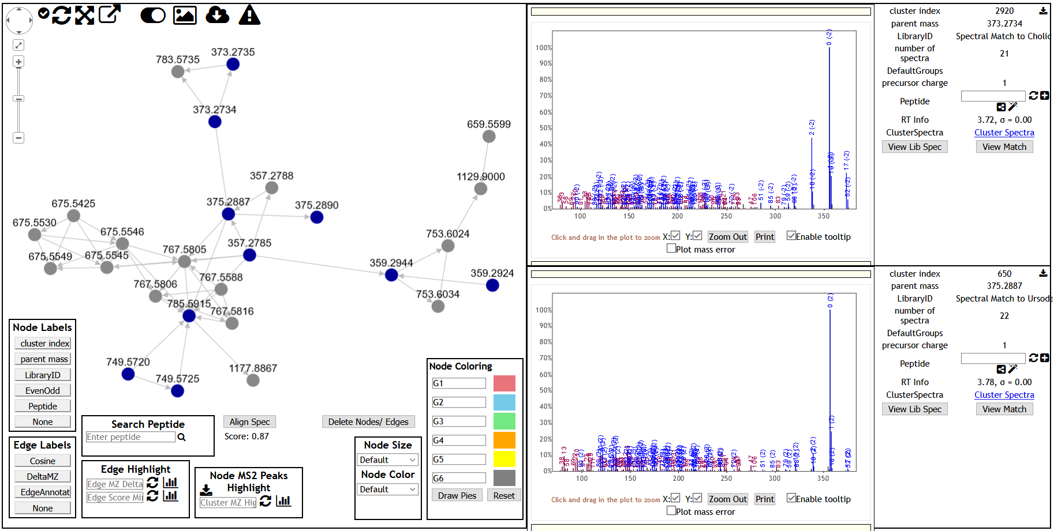
Visualizing the network
Click parent mass

Slide 12
What else can be done in the GNPS platform with the feature-based molecular network?

Slide 13
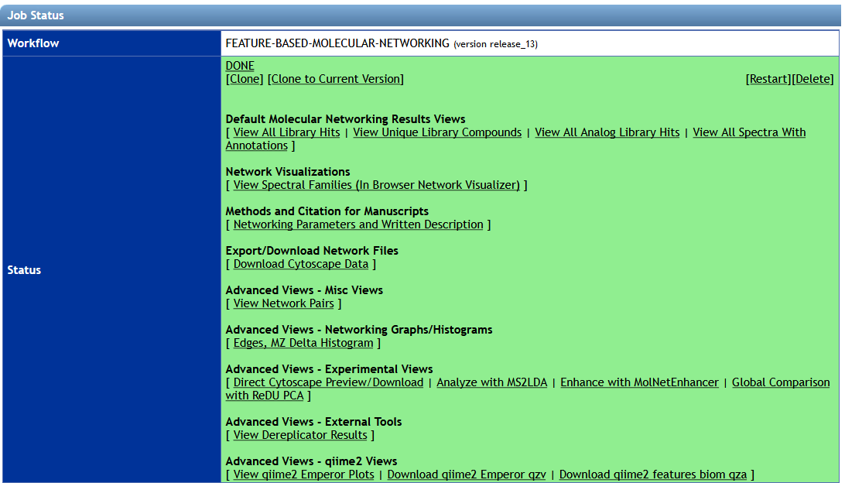
Export/Download Network Files
Cytoscape

Slide 14
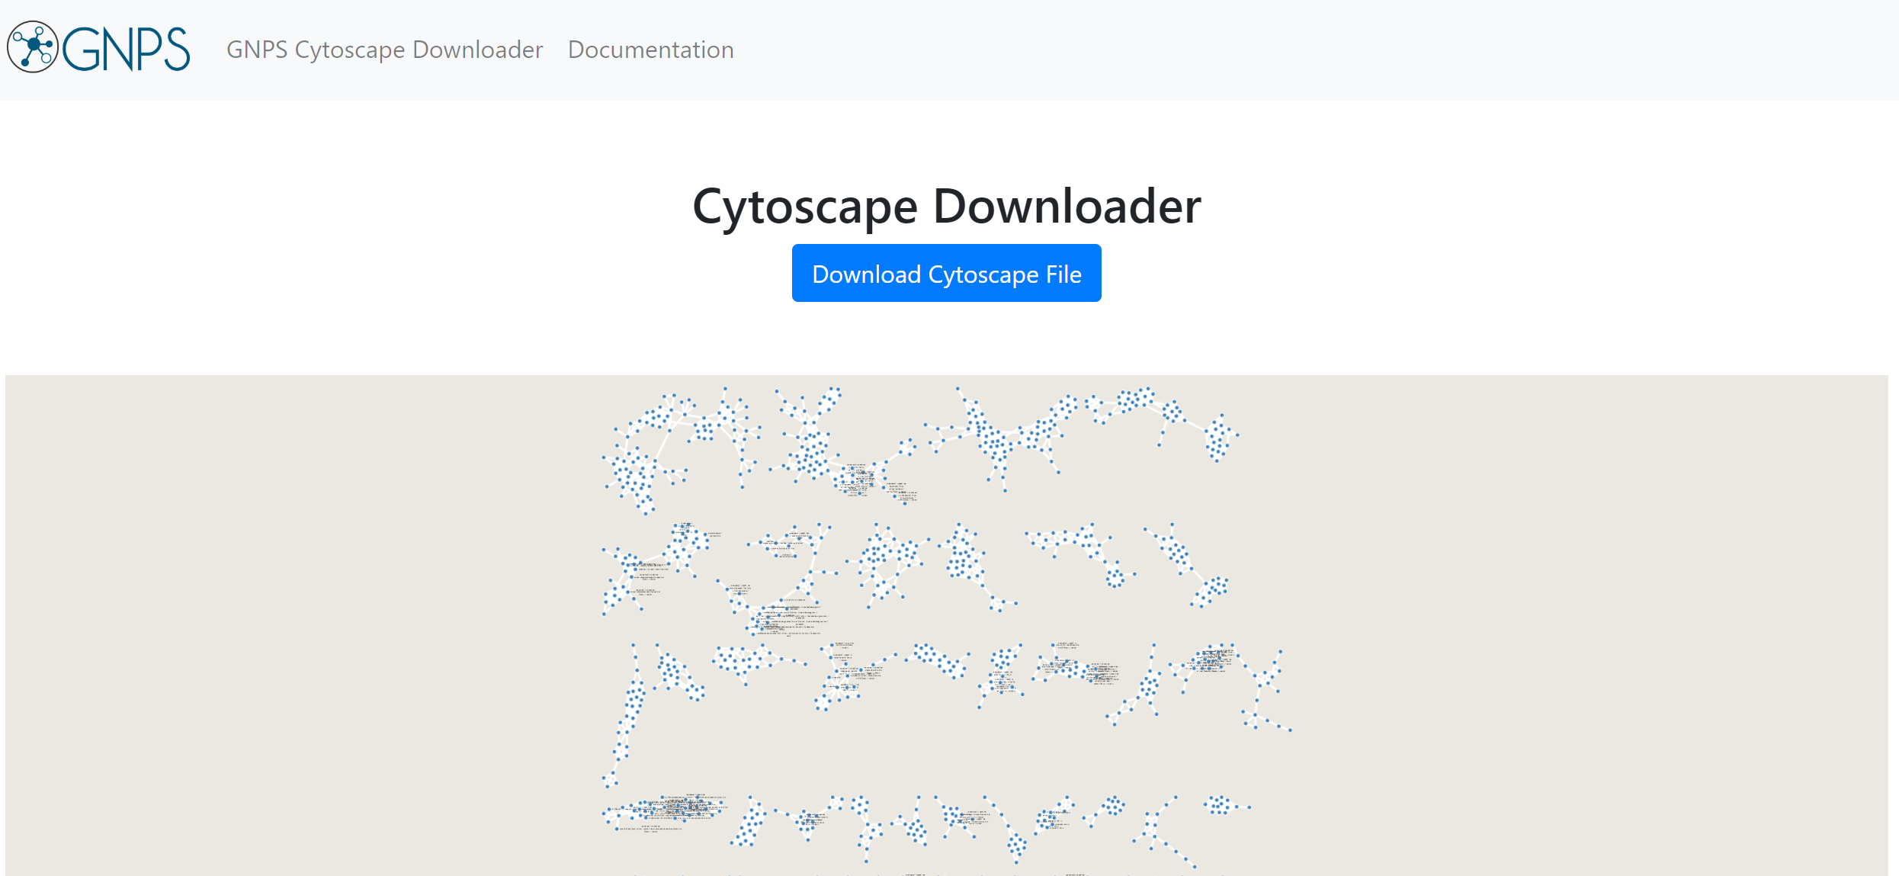
Export/Download Network Files
Cytoscape

Slide 15
Global Comparison with ReDu

Slide 16
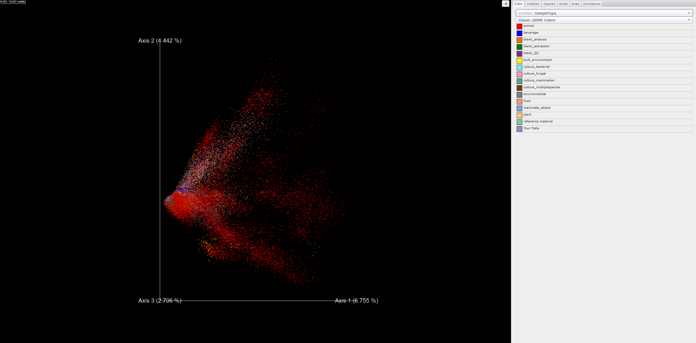
Global Comparison with ReDu
PCA plot
Your Data

Slide 17
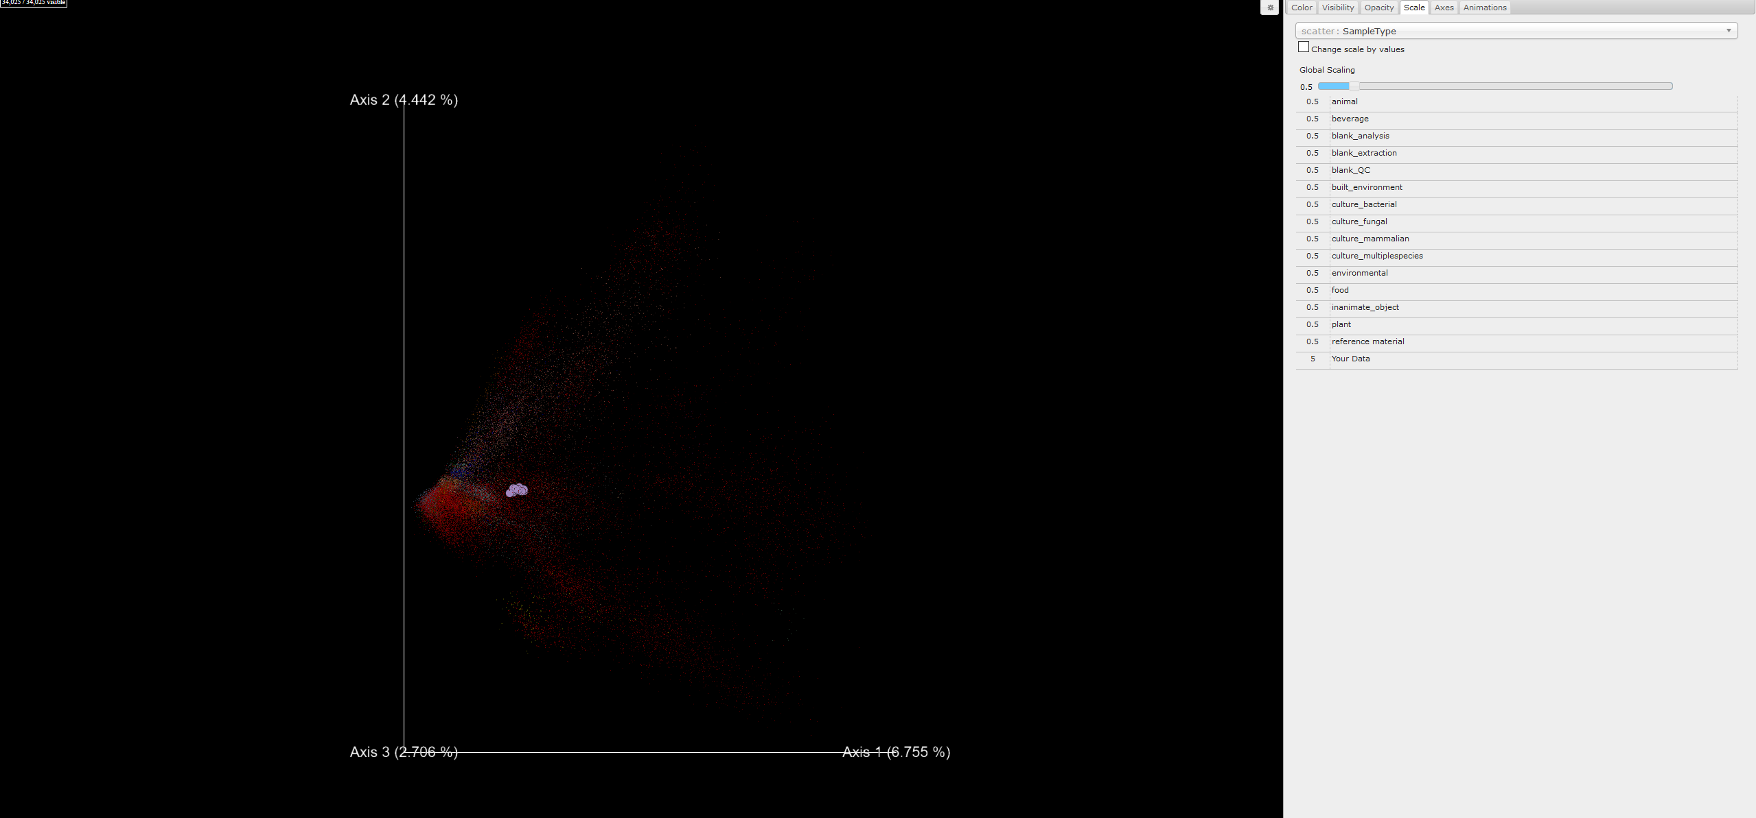
Global Comparison with ReDu
PCA plot
Scale
Your Data

Slide 18
Enhance annotations
These will be discussed with in silico annotations

Slide 19
Workshop Tasks:
Find bile acid-related compounds in the dataset.
What is the parent mass and more common mass difference found among some bile acid-related compounds you found? Explore GNPS platform
When selecting Groups “Less_than_5” and “More_than_30”, in what groups you found bile acid-related compounds? Explore Cytoscape

Slide 20
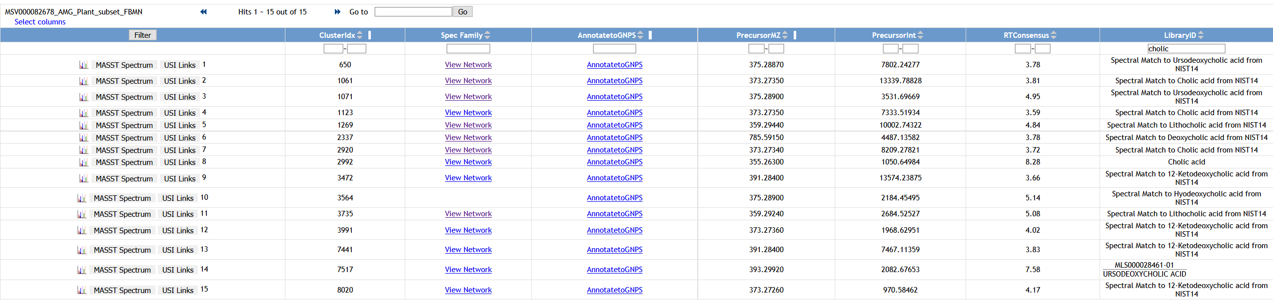
Workshop Tasks:
1. Find bile acid-related compounds in the dataset.

Slide 21
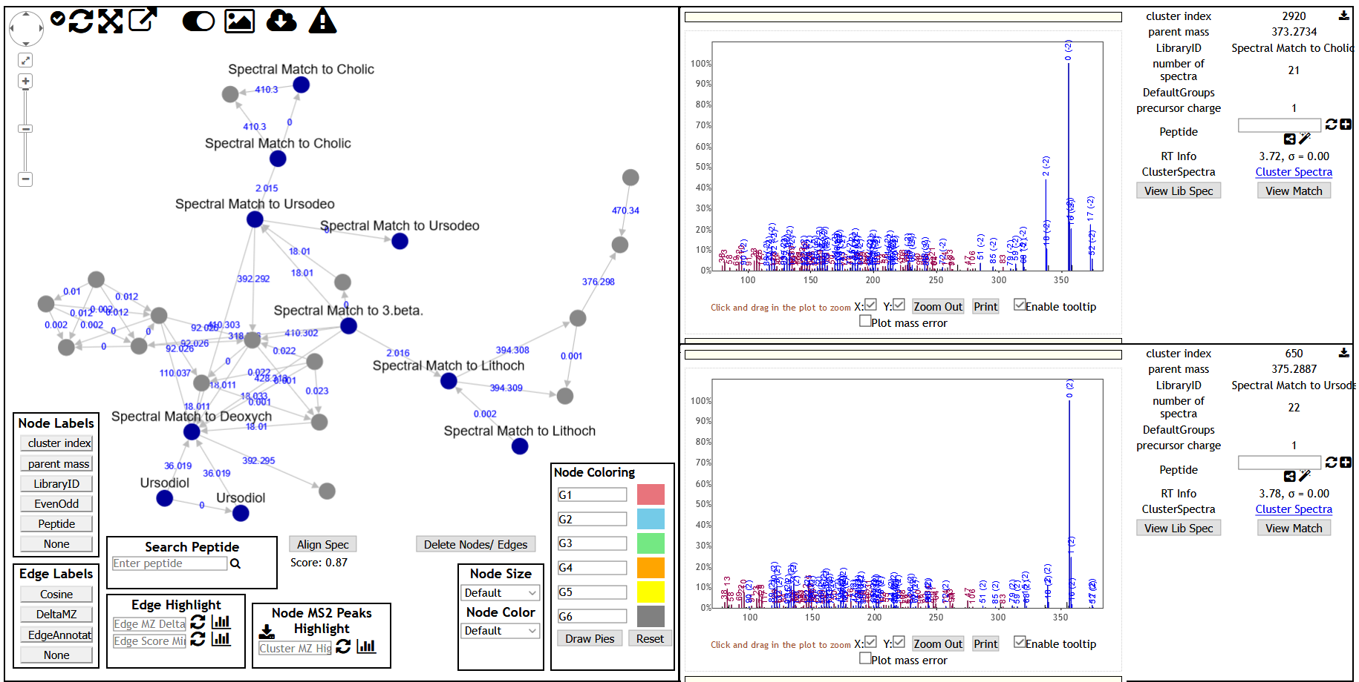
Workshop Tasks:
2. What is the parent mass and more common mass difference found among some bile acid-related compounds you found? Explore GNPS platform

Slide 22
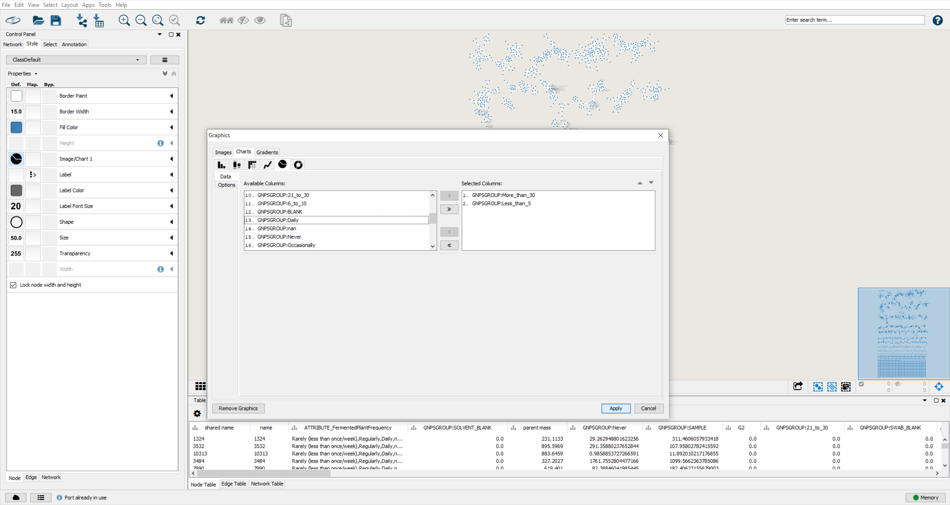
Workshop Tasks:
3. When selecting Groups “Less_than_5” and “More_than_30”, in what groups you found bile acid-related compounds? Explore Cytoscape

Slide 23
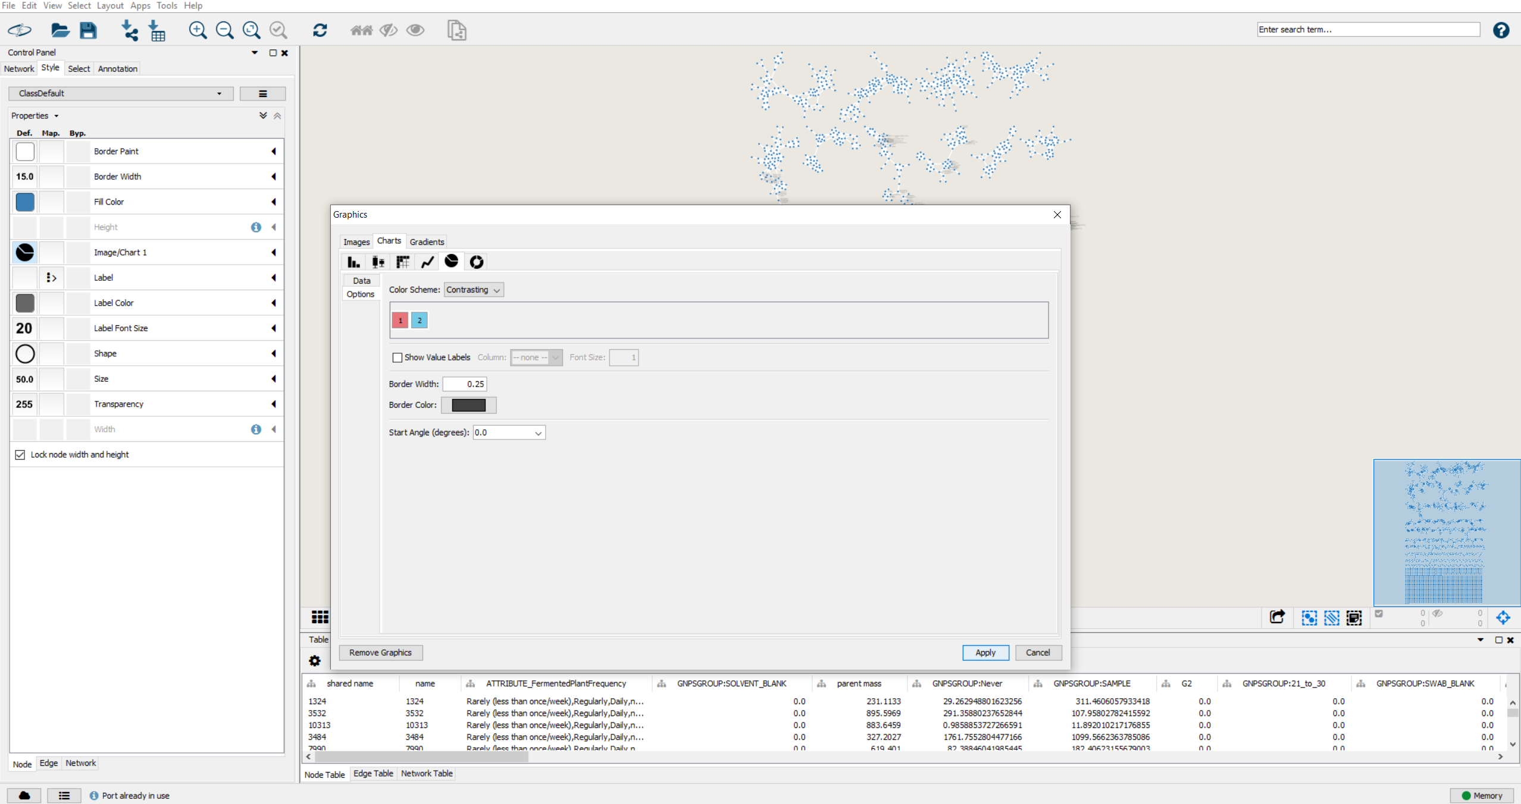
Workshop Tasks:
3. When selecting Groups “Less_than_5” and “More_than_30”, in what groups you found bile acid-related compounds? Explore Cytoscape

Slide 24
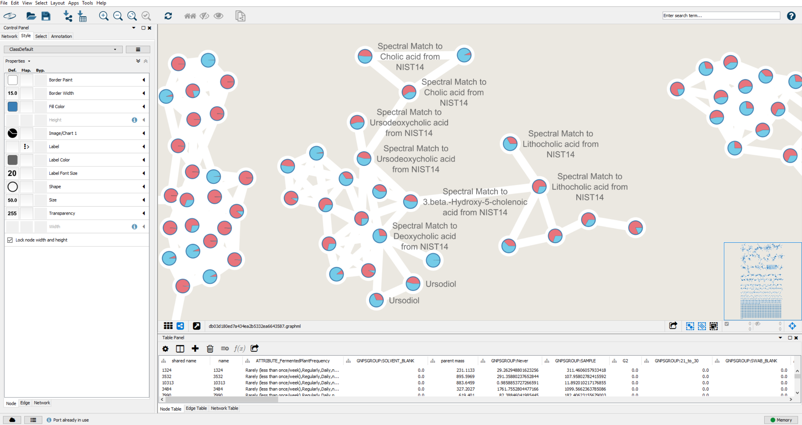
Workshop Tasks:
3. When selecting Groups “More_than_30” and “Less_than_5”, in which groups you found bile acid-related compounds? Explore Cytoscape

Slide 25
Questions, Problems or Bugs?
Documentation: https://ccms-ucsd.github.io/GNPSDocumentation/
Forum: https://groups.google.com/forum/#!forum/molecular_networking_bug_reports
PRESENTER’S NAME
E-mail

